Slide 1
ITE 240 Case Study A Huge semaphore based on os Course instructor: DR. Surekha lanka Ethereal Dolan White (1902140011) Mohamed Rahmid Sufin (1906210003) Mumtahina Arefin Mim (1902260016) Fardina Kabir (1910080005)

Slide 2
Abstract In this paper we will discuss the basic synchronization and current issues of the semaphores. We will find the root cause of the problem of the critical section in the OS. In this project, we will emphasize how current multi processors are intensifying the issues on coordinating and accessing the resources. This paper will also concentrate on when to use a mutex, a category of binary semaphore, versus using a standard semaphore, as well as comparing those advantages and disadvantages of both as well. Lastly, another goal is to dictate when it is best to use binary and counting semaphores. Regardless of its imperfections, this project will show that a semaphore is boon to any operating system.

Slide 3
Introduction Dijkstra introduced a modern and quite important strategy for handling concurrent processes. This integer variable is known as semaphore. Semaphores are used for solving the critical section issues and accomplish multiprocessing process synchronization. They are machine-independent; they function in the micro processor's machine-independent code. There are also two types of semaphores,. Binary semaphores are used for implementing mutual exclusion also known as mutex. . Counting semaphores are used to implement bounded concurrency also known as bounded waiting. It eliminates deadlock as well as busy waiting. Semaphore programming is complicated and difficult, odds are that mutual exclusion would not be executed. Their use is not enforced, it is rather instead by convention.

Slide 4
Case question N0.1 1)What are the main causes or reasons that leads to the problem of critical section in OS and its solution? Based on synchronization, processes are classified as one of the two main types: Independent Process : The implementation/execution of a process does not influence the performance of the other/another processes. Cooperative Process: Performance of a process causes effects on the another’s operation. Process coordination(or Synchronization) issues often occur in the case of the Cooperative Process when the resources are distributed in the Cooperative Processes. Race Condition If more than one process runs the same code or accesses the same memory or any common variable in that situation, there is a probability that the result or validity of the shared variable is false, such that all the processes running the race will claim that the result is accurate to this known as race situation. Several processes enter and execute the modification of the same data at the same time, but the result depends on the precise order in which the entry takes place.

Slide 5
Critical Section Problem:
A CS is a compiler section which tries to access and must execute shared variables as a nuclear measure. This means that only one process must carry out its critical section at a given time in a cluster of cooperative processes. If some other process wants its critical section to be executed, it needs to wait until the first process.
The entry section manages the entry in the cs in the Figure 1 diagram. It obtains the necessary resources to carry out the process. The exit area manages the exit from the critical area. It discloses the resources and informs the other processes of the free CS.
Any solution to the critical section problem must satisfy three requirements:
Mutual exclusion is a method in which the processes undergo in the CS i.e. between the entry and exit protocol. Only 1 process must execute in its CS for the prevention of race condition. Critical section(CS) is functioned in such a way so that all the processes must subject to mutual exclusion and work together.
Progress :When no processes are conducted inside the CS and other processes choose to join the CS, then such processes can not be included and do not operate in its remaining portion. In addition, the other processes do not hold the rights to stop the process that is closest to the entry portion that grants permit to the CS or critical section for the completion of execution.
Bounded Waiting :There is an extent until which a process should wait for entry to the cs, in simple terms it should not wait for a very long period.
Do {Entry Section Critical Section Exit Section Remainder Section } While (TRUE)
Figure 1 : Critical Section Problem code (Introduction of Process Synchronization - GeeksforGeeks, 2020).

Slide 6
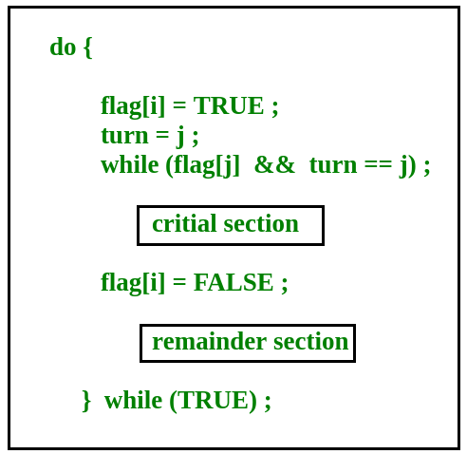
Boolean flag[i] :Initialized to FALSE, at first not any is interested in accessing the critical segment. int turn : The turn is for the process that is willing to access the critical section. Figure1: Peterson’s solution code (Introduction of Process Synchronization - GeeksforGeeks, 2020)
Peterson’s Solution to CS problem:
Peterson’s Solution is a conventional solution or method to the critical section problem based on software.
In Peterson’s solution, we have two shared variables:
Peterson’s Solution preserves all three conditions :
Mutual Exclusion makes sure the entry of one process to the CS at a time.
Progress also promises that a process waiting in queue outside the CS cannot prevent other processes from accessing the CS
Bounded Waiting is preserved because all the processes will receive equal opportunity.
Figure2 : Peterson’s solution (Introduction of Process Synchronization - GeeksforGeeks, 2020)

Slide 7
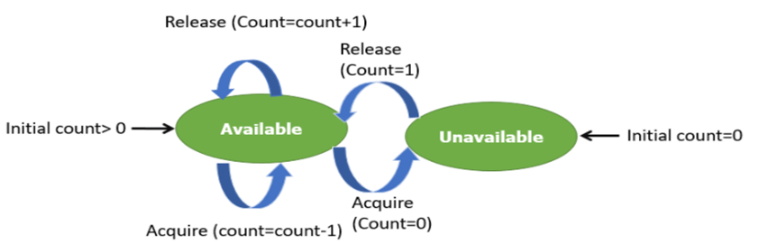
Case question N0.2 2.When should binary and counting semaphores be used and what are they? There are two sorts of semaphores, which are binary and counting semaphores. Counting Semaphore—the whole type of semaphores uses a count to help acquire or release tasks several times. Unless the initial count = 0, the counting semaphore in the incomplete state must be generated When used?
Figure: Counting Semaphore ("Semaphores in Process Synchronization - GeeksforGeeks", 2020).
A counting semaphore is often used to control access to multiple or perhaps more resources in a pool. For example, They can have any value and are not restricted over a certain domain. They can be used to control access to a resource that has a limitation on the number of simultaneous accesses. The semaphore can be initialized to the number of instances of the resource. Whenever a process wants to use that resource, it checks if the number of remaining instances is more than zero, i.e., the process has an instance available. Then, the process can enter its critical section thereby decreasing the value of the counting semaphore by 1. After the process is over with the use of the instance of the resource, it can leave the critical section thereby adding 1 to the number of available instances of the resource.

Slide 8
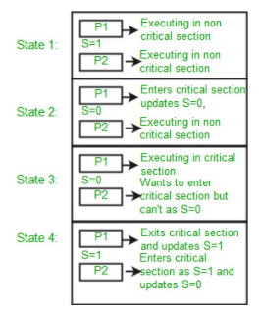
Binary Semaphore and when used
Binary Semaphore -The binary semaphores are quite similar to counts, but they have a value of 0 and 1. In this semaphore type the waiting operation works only if semaphore = 1, and when semaphore = 0, it is successful. It is easy to apply rather than count semaphores.
When Used:
To handle access to a singular resource, a binary semaphore could be used. In general, for a critical section of the user code it can be utilized to promote mutual exclusion. In this case, the semaphore will be generated with an original number to signify that a critical code section is not executed. A task must identify the method for obtaining the semaphores when entering the critical section, in order to prevent further tasks being entered. When leaving the critical area, the job must specify the release method for the semaphore to allow a different task to perform the critical section.
Figure 2: Binary Semaphore ("Semaphores in Process Synchronization - GeeksforGeeks", 2020).

Slide 9

Semaphores operate using wait and signal and can be an integer. In the case of a binary semaphore, 0 and 1 will be used. For counting semaphores, finite number will be used (1,2,3,4,5…n). mutex falls into the binary semaphore category. It uses a 0 and 1 as well, however, it acts as an object rather than an integer. If a resource must be acquired, the process will utilize a lock on the mutex object. That lock can only be released by the process using the lock.
Case Question no. 3
What are the advantages, disadvantages of semaphore and its comparisons to mutex (a category of binary semaphore)?
The key difference between a semaphore and mutex is that a semaphore utilizes signal and mutex’s utilizes a locking mechanism.
.
When do you use a semaphore vs a mutex?
To put it simply, it is best to use a semaphore when there is signaling from one task to another or many resources are available. Likewise, it is best to use a mutex when there is only one shared resource.
Figure 3: Semaphore and Mutex (“Semaphore Vs. Mutex - A Clear Understanding”,2020) .

Slide 10
Conclusion
In this essay, we discussed the basic synchronization of the semaphores as well as current problems. We identified the root problem in the OS of the critical segment. In this project, we demonstrated how current multi-processors worsen the problems of resource alignment and access. In parallel, this essay was focused on when to use a mutual exclusion, a binary semaphore class, against using a regular semaphore, as well as comparing each of these pros and cons. Furthermore, another aim we determined in this project is when it is ideal to use binary and counting semaphores. From this project our team members learnt that how we illustrated, regardless of its flaws, that a semaphore is very helpful to any OS.

Slide 11
Slide Tite
REFERENCES
Ahlawat, A. (n.d.). Process Synchronization. Study Tonight. Retrieved September 2, 2020, from https://www.studytonight.com/operating- system/process-synchronization
A.T. (n.d.). Process Cooperation in Operating Systems: Definition & Examples. Study. Retrieved September 10, 2020, from https://study.com/academy/lesson/process-cooperation-in-operating- systems-definition-examples.html
Introduction of Process Synchronization. (2019, September 11). GeeksforGeeks. https://www.geeksforgeeks.org/introduction-of- process-synchronization/
Jain, P. (2018, August 13). Cooperating processes in the Operating System. Includehelp. https://www.includehelp.com/operating- systems/cooperating-processes-in-the-operating-system.aspx
Meador, D. (2018, October 10). Semaphores in Operating System. Tutorial Points. https://www.tutorialspoint.com/semaphores-in-operating- system
OS Paterson Solution - javatpoint. (n.d.). JavaTpoint. Retrieved September 3, 2020, from https://www.javatpoint.com/os-paterson-solution
Process Synchronization. (2002, September 23). SpringerLink. https://link.springer.com/chapter/10.1007/0-306-46976-6_7
rajkumarupadhyay515. (2020, April 28). Concurrent Processes in Operating System. GeeksforGeeks. https://www.geeksforgeeks.org/concurrent- processes-in-operating-system/
Rungta, K. (2020a, August 8). What is Semaphore? Binary, Counting Types with Example. Guru99. https://www.guru99.com/semaphore-in- operating- system.html#:%7E:text=Summary%3A,acquired%20or%20released% 20numerous%20times.
Rungta, K. (2020b, September 16). Mutex vs Semaphore: What’s the Difference? Guru99. https://www.guru99.com/mutex-vs- semaphore.html
Semaphore in OS (Operating System). (2019, March 20). STechies. https://www.stechies.com/semaphore-os_1/
Semaphore Vs Mutex: What Is The Difference? (n.d.). Viva Differences. Retrieved September 1, 2020, from https://vivadifferences.com/13- difference-between-semaphore-and-mutex/
Semaphores in Process Synchronization. (2019, November 20). GeeksforGeeks. https://www.geeksforgeeks.org/semaphores-in- process-synchronization/
Shriram Vasudevan. (2020, January 16). Semaphore Vs. Mutex - A Clear Understanding. YouTube. https://www.youtube.com/watch?v=8wcuLCvMmF8

Slide 12
Thank you for listening ☺
Time for questions!

